Slide 1
TEAM MANAGER’S MEETING
This is an E Briefing, we expect you to read this - no exceptions

Slide 2
WELCOME – E BRIEFING
Event Manager: Chris Christensen
Race Manager: Shanelle Barrett
PCP: Brendan Patterson
Assistant Commissaires: Mark Ireland, Graeme Bell, Heather Smyth, Lisa Landers, Graeme Moffat, Mary Ingle, Stuart Weston, Nick Spark.
This briefing is for managers - you are responsible to pass information onto your riders
Mouat, Mary Ingle, Lisa Landers, Stuart Weston

Slide 3
GENERAL EVENT INFO
Event Manual – online
Race Office – CNZ Schools Tent at venues
Timing transponders – CNZ Schools Tent
Results - online
Medal Presentations – Throughout the day Sunday for Hill Climb & Criterium next to the Race Office
Smoke, vape, drug, alcohol and drone free event
Volunteers – report to race office – every school needs 1 volunteer
Food/Coffee - available at venues
Waste Management – use recycle bins provided
Contingency plans – text, email, Facebook
Mt Wellington – ABSOLUTELY NO RIDING ON THE GRASS - ANYWHERE

Slide 4
HEALTH & SAFETY
Medics onsite – adjacent to event Start lines
Medical Centre details in event manual
Notify a commissaire or event staff ASAP if a rider withdraws
Health & Safety is everyone’s responsibility
Report any hazards or incidents to the Event Manager or to CNZ Schools Tent
For the safety of the event continuation please ensure riders stay on the road at all times. Riding off road on the maunga will jeorpardise the future use of Mt Wellington

Slide 5
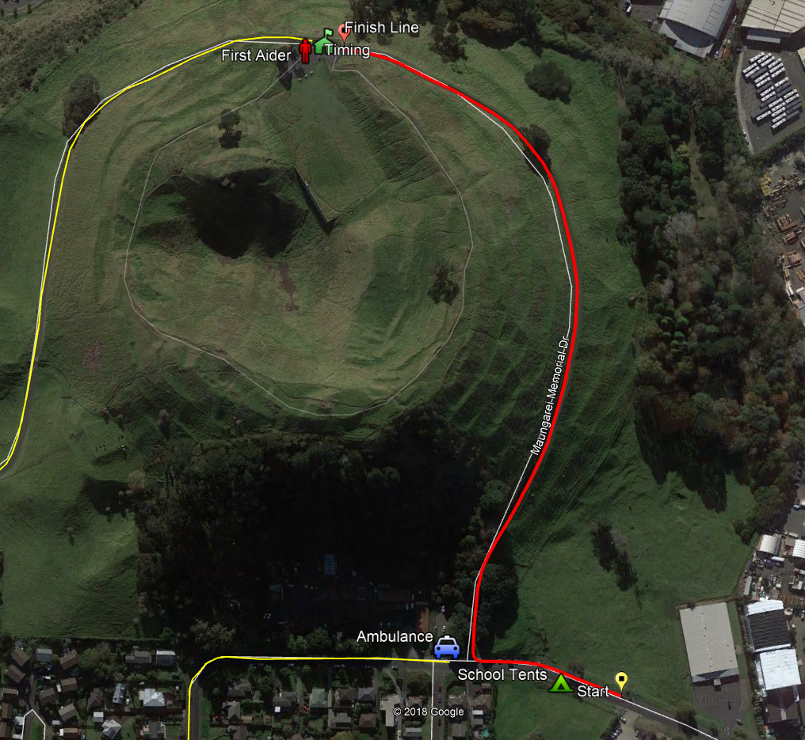
MAUNGAREI Mt Wellington
Maungarei means watchful mountain
One of the best preserved maunga pa in Tamaki Makaurau
Aucklands second youngest volcano, last erupted around 10,000 years ago
The maunga has archaeological features that are highly sensitive
Visitors must take care when on the mountain to only ride on the road/do not ride off the road anywhere
No Parking
in Skateland

Slide 6
Hill Climb
No Parking or riding in Skateland
Medical – Ambulance at entrance to climb and Medic at top of hill
Residents still have access on Mountain Road
Be courteous of other riders
Be courteous to drivers/residents
No Parking
in Skateland

Slide 7
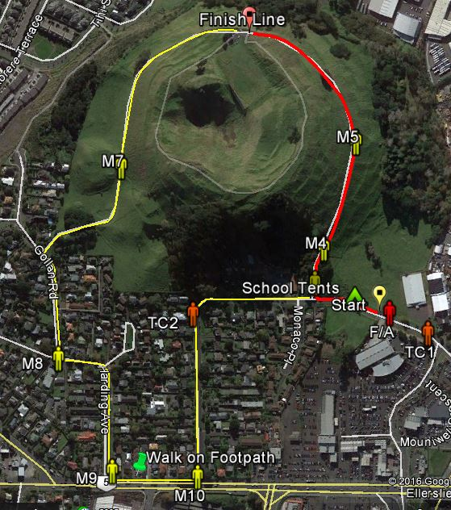
Hill Climb
Return Ride
Judder bars on the downhill – be careful!
Ellerslie-Panmure Highway. Riders must dismount & walk their bikes along footpath – this is a Council requirement.

Slide 8
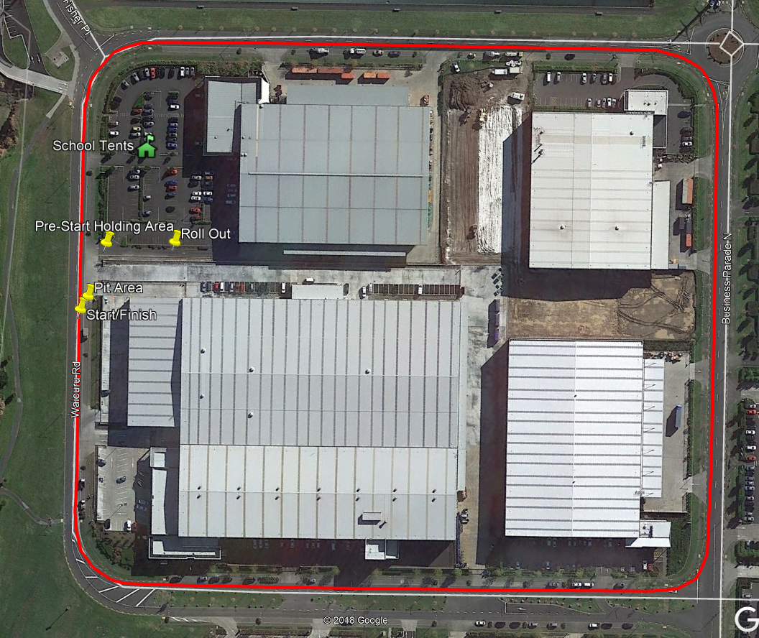
Criterium
Event Vehicles on course – medical etc – slip lane
Medical – in the following locations
Start/Finish – Ambulance
Business Parade – Ambulance
Commissaire Vehicle – Medic
Cyclists to use left lane only
Narrow section/fencing
DON’T ride in right lane
Notify Marshals if athlete withdraws

Slide 9
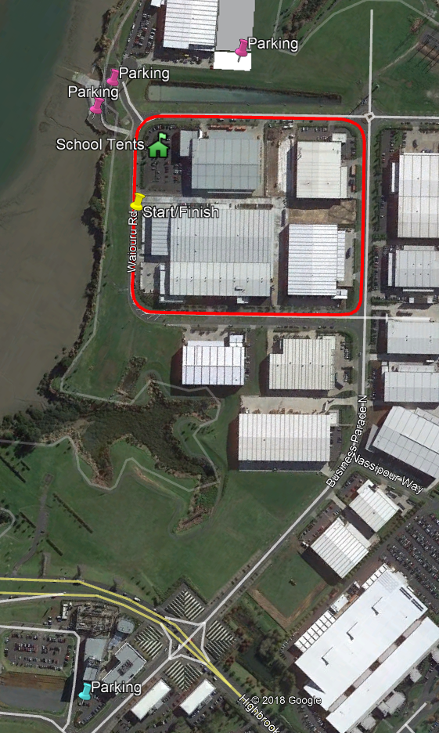
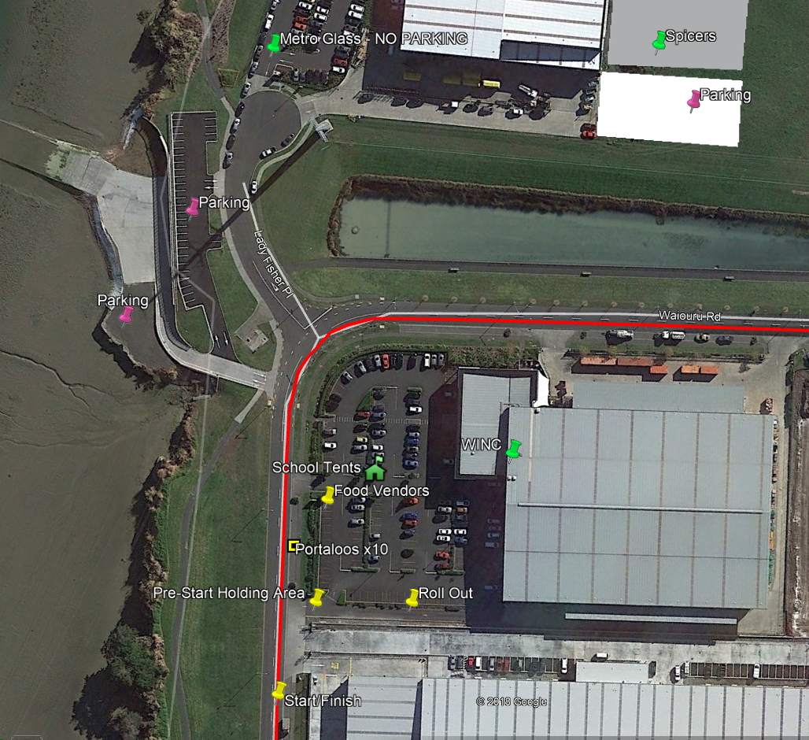
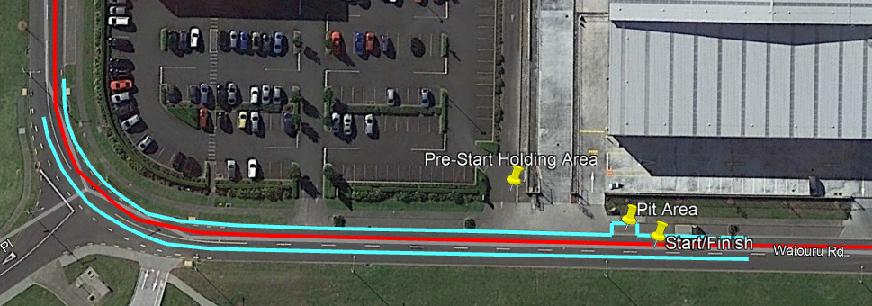
Criterium
Tent setup, including trailers can be in NXP carpark 2 time slots for leaving early (tbd)
No littering or walking through gardens or leaning bikes on the buidings– please respect the area
No Parking on course or in business carparks (except Spicers)
Be careful and go slow when leaving. Please listen to marshals instructions
Additional parking outside the business park area
Be careful when crossing the road
Slip lane for vehicles – DO NOT stand on road to watch race

Slide 10
PCP Information
Schools Cycling rules - here
Scratchings – please report any scratchings to the CNZ Race Tent
Bikes strictly on the road only on Mt Wellington (Do not go on the grass)
Littering – not littering during the racing
Rider etiquette
Uniform – school cycling kit – please check the rules
Medal presentations – school cycling kit or school uniform & covered shoes only!

Slide 11
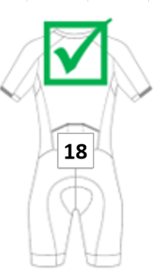
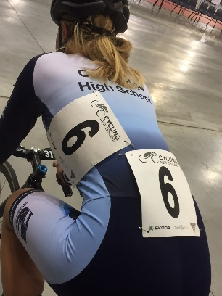
PCP Information
Individual Time Trial & Hill Climb
One number – to be placed centrally on lower back
Seat post sticker
Criterium
Two numbers – to be placed centrally on lower back and
on left hand side of the jersey.
Seat post sticker

Slide 12
Any questions?
email schools@cnz.kiwi
Good luck, race hard, fair and safe

